Slide 1

160779

Slide 2


Overview of Data pre-processing
For the Target variable - Absenteeism time in hours (Numeric type), we have 20 features of which 8 are Nominal, 8 are Numeric and 4 are Binary. Plotting the correlation matrix, we find that (Service time, Age) and (Weight, Body mass index) are highly correlated (correlation value of magnitude greater than 0.65 are considered as highly correlated) and based on the correlation value with the target variable, we remove Service time and Weight feature from the dataset.

Slide 3
Steps for Data pre-processing

Slide 4
Checked for data type of the feature
At first, all the data was stored as integer, however there were few categorical type columns were present in our dataset. The columns are on given on the right side. We changed them from integer to category.
Reason for absence
Month of absence
Day of the week
Seasons
Education
Disciplinary failure
Social drinker
Social smoker.

Slide 5
Checking for NA values
We were performed a check for NA and nan values which resulted in no such values present in our dataset.
Handling invalid data in reason for absence
Reason for absence took reasons as values from 1 to 28. For the data such as 0, we used 26 by default in them which was identified as Unjustified Absence.

Slide 6
Mapping value of character attributes to its pre-defined categories
As our categorical features were represented by numerical values, with the help of data description, we mapped categorical features to their pre-defined categorical labels. Mapping is shown on the right side.
Reason for absence- Reason_Justified
Month of absence - Month_Name
Day of the week – Day_Name
Season – Season_Name
Education – Education_Details
Disciplinary failure – Disciplinary_Status
Social drinker – Drinking_Status
Social smoker – Smoking_Status

Slide 7
Inconsistency in Month Column
For values other than 1 to 12 we dropped the data points. It would have been incorrect to replace them with them with something between 1 and 12.
Inconsistency in ID Column
We collected all the unique IDs in the dataset. There were some which were repeating but had different features, so we deleted the one which was different from the others as unique ID has unique attributed with them.

Slide 8
Inconsistency in Absenteeism time in hours column
0 in absenteeism is a discrepancy and we need to specify some value so that there aren’t any contradictions. Those datapoints where there was no indisciplinary status, they were replaced by average value of absenteeism time. Those with indisciplinary status were assigned maximum occurring number in disciplined status.

Slide 9
Extracting useful information by using calculation of features
For efficient analysis, we created some new features which are derived from existing features. Following are listed:
Joining Age = Age – service time
Travel expense per km = Transportation expense/Distance from residence to work
Age_Group – Age<35 ; Young employee
35<Age<45 ; Mid-age employee
Age>45 ; Old employee
BMI_status- Body mass index<18.5 ; Underweight
18.5≤Body mass index<24.9 ; Normal
24.9≤Body mass index≤29.9 ; Overweight
Body mass index>29.9 ; Obese
Travel cost category - Travel Expense per km<7→Cheap
7 ≤Travel Expense per km ≤15→Affordable
Travel Expense per km >15 →Expensive

Slide 10
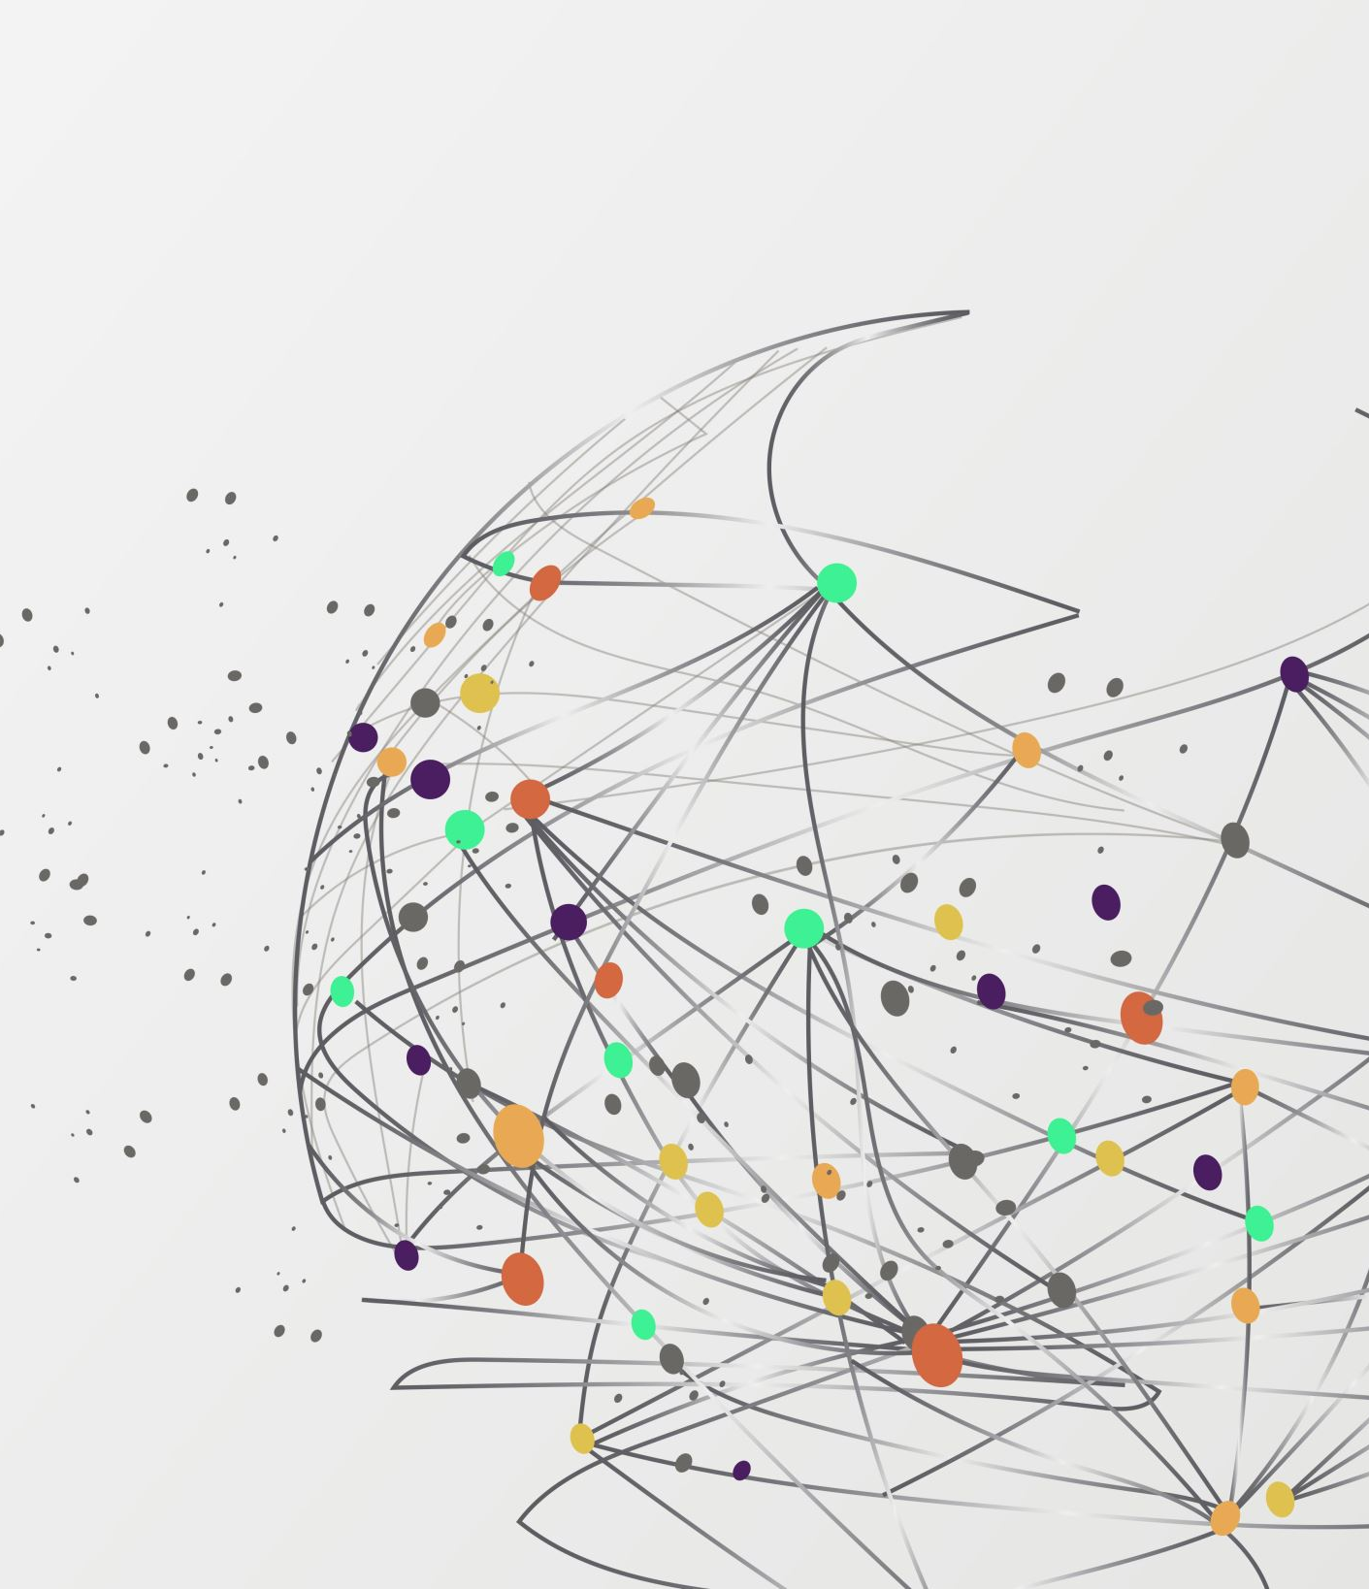
GRAPHS AND INSIGHTS
We used the pre-processed data and tried to draw some useful insight by drawing different graphs.

Slide 11
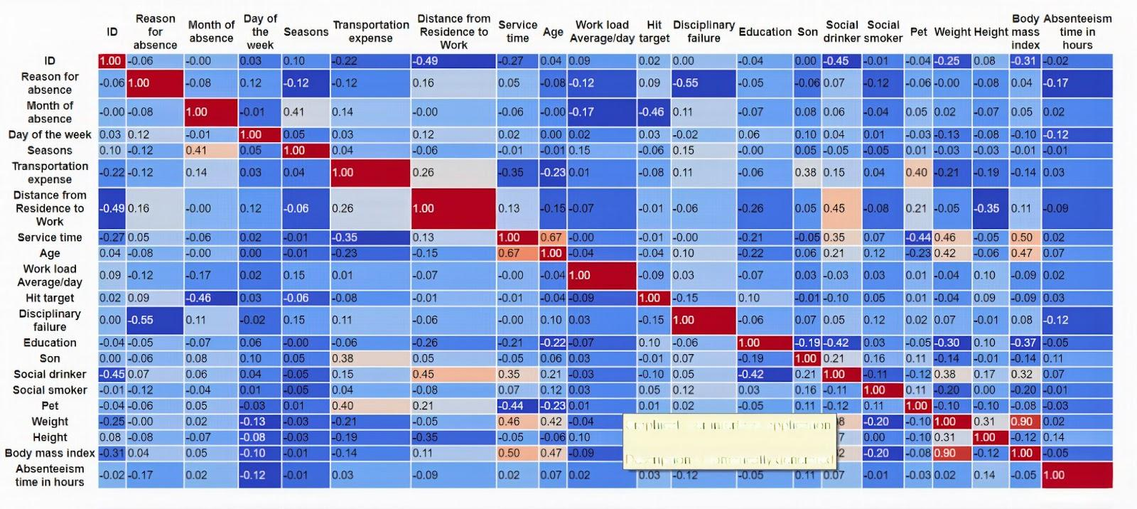
CORRELATION GRAPH
A correlation graph is a table that displays the coefficients of correlation between variables. Positive correlation, negative correlation, or no connection can all be shown in graphs. A positive correlation suggests that as one variable rise, the other rises as well. A negative correlation suggests that while one variable rises, the other falls. They have a sour relationship, and zero means no relation is there.
INSIGHTS → Most of the correlation values are close to 0, showing that no significant interaction exists. However, a few correlation values near |0.45| indicate marginal interactions among selected features

Slide 12
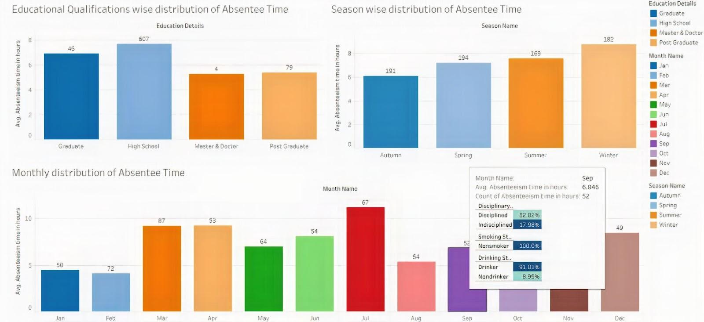
Time absenteeism based on key characteristics like educational background, seasonality, and month of the year
Educational Qualification wise Absenteeism Time
Insight: Most of the students attending the high school graduation were absent the majority of the time.
Season wise Absenteeism Time
Insight: The highest percentage of absences occurred during the winter and spring seasons.
Monthly distribution of Absenteeism Time
Insight: Based on our observations, during the months of June and July i.e., during winter season, we observe a higher incidence of absenteeism than during the other months. In addition, the lowest percentage is observed during January and February.

Slide 13
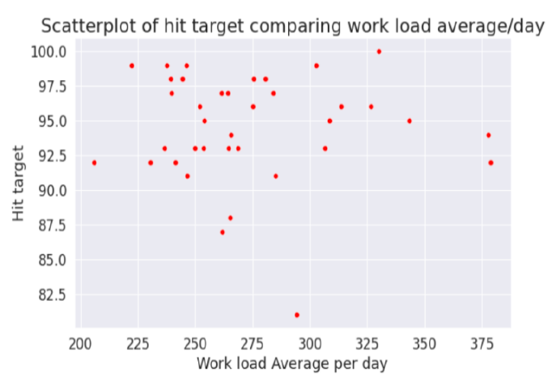
Workload average per day and hit target scatterplot
INSIGHT : This graph shows that as the workload rises, we notice a significant drop in the hit percentage. Additionally, it is evident that when the workload was below 275, most of the employees achieved their objectives.

Slide 14
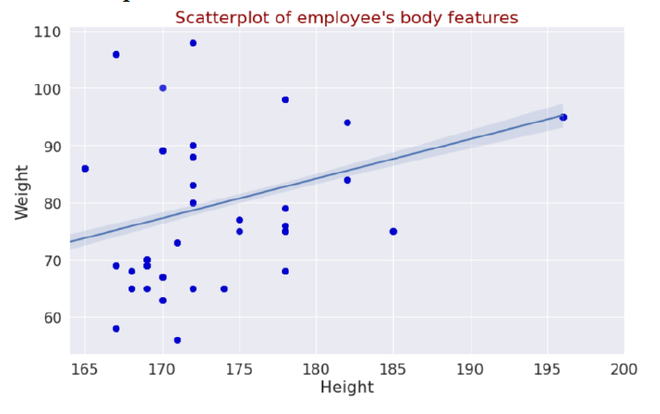
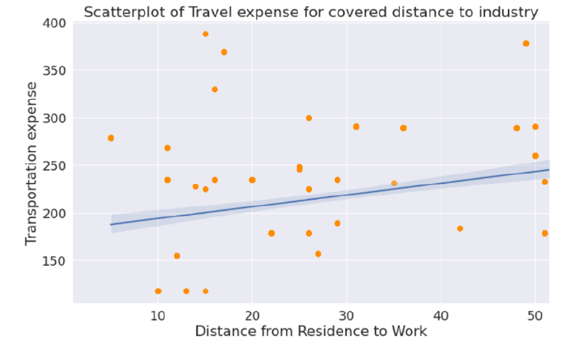
Diagrams of certain attributes with lines of best fit drawn from linear regression
INSIGHT : The graph shows that distance from residence to work and transportation expense have a linear relationship. In addition, the positive slope of the linear regression line implies that as the distance between home and work increases, then the corresponding transportation expense increases as well

Slide 15
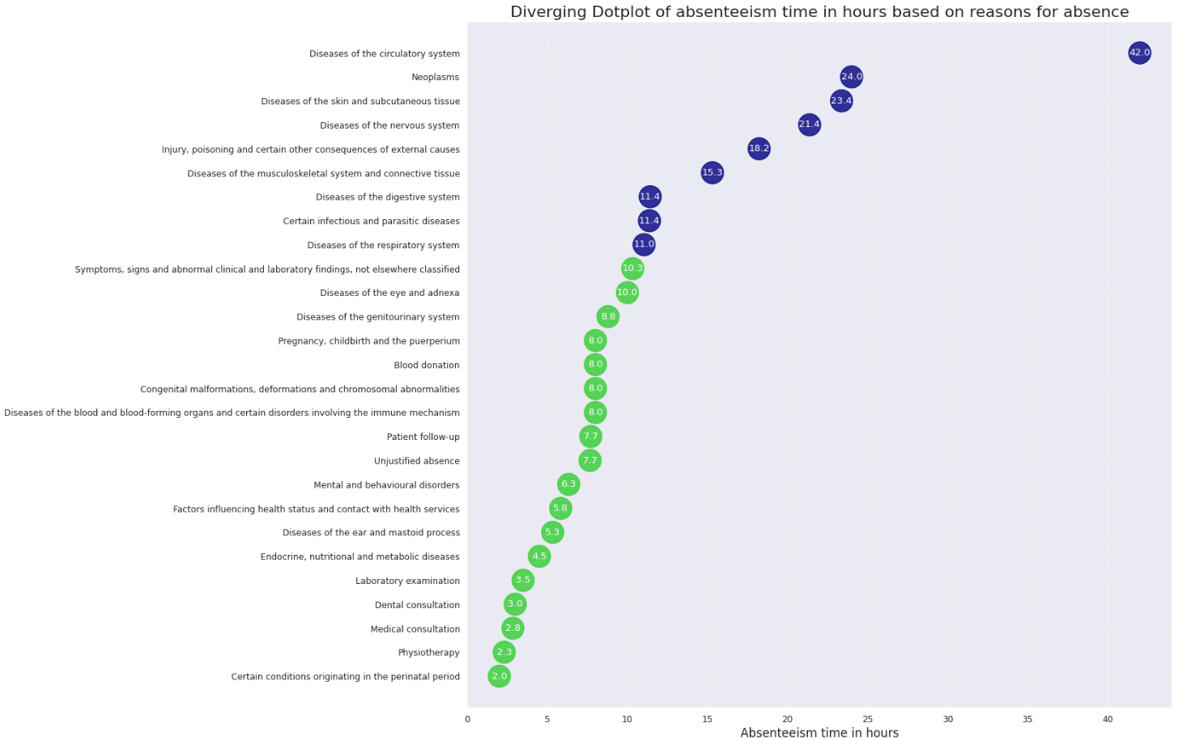

Diverging Dot Plot for absenteeism time based on Reasons for Absence

Slide 16
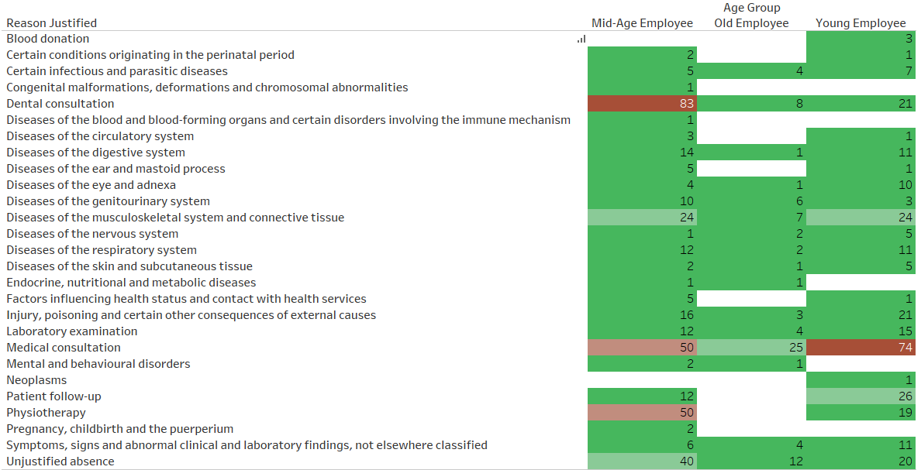
Reason of Absence frequency for different Age groups

Slide 17
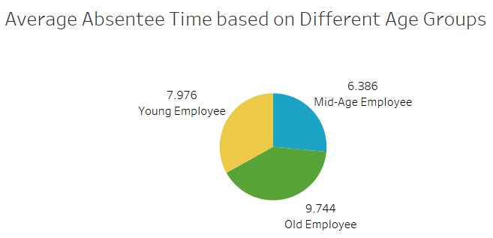
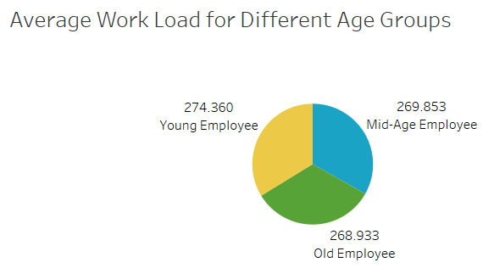
Average Absenteeism time and Work load for different Age groups
• Average Absenteeism Time based on Age Group : It can be observed that Old Employee tend to remain absent higher than that of Young and Mid-Age Employee. One of the reasons for this might be since the Old Employees are more susceptible to disease and they tend to possess less immunity.
• Average Workload based on Age Group : The graph indicates that the workload between all the Age categories is evenly distributed.

Slide 18
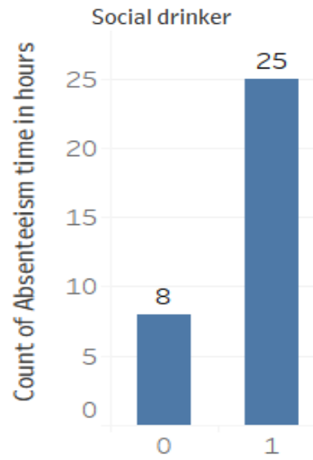
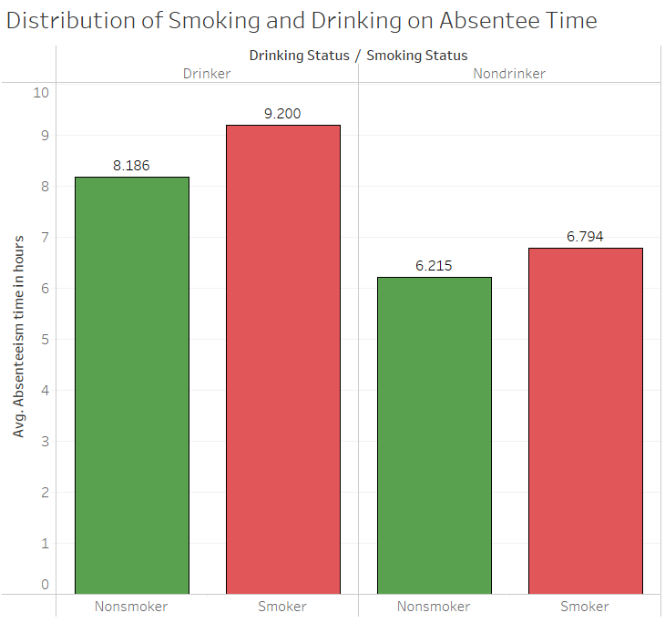
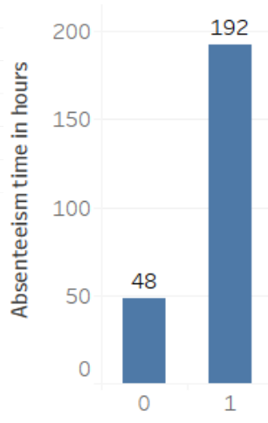
Negative Impact of Smoking
The plots on the left show the relationship between the absenteeism data with unjustified reason and the social drinking status of the employees. We can see that the major portion (~80%) of the absence belongs to the group which agrees to drink socially which may be considered as one of the major reasons for their unjustified absence.

Slide 19
Negative Impact of Smoking
The plots on the left show the relationship between the absenteeism data with unjustified reason and the social drinking status of the employees. We can see that the major portion (~80%) of the absence belongs to the group which agrees to drink socially which may be considered as one of the major reasons for their unjustified absence.

Slide 20
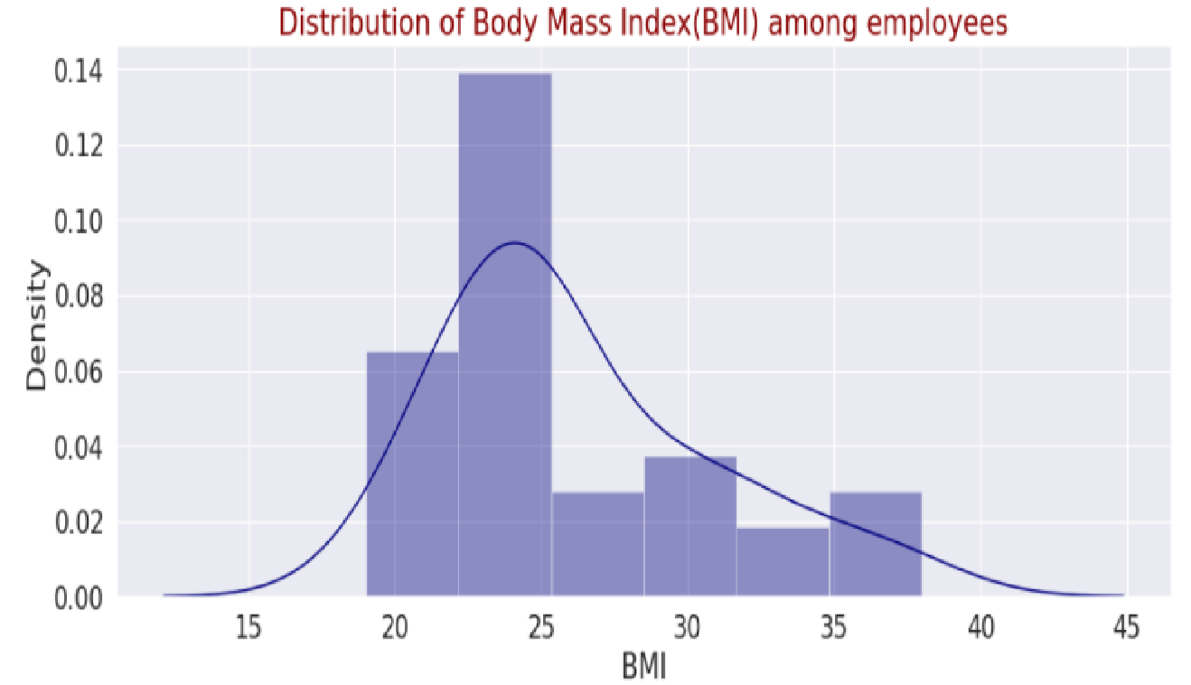
5. Density curves with Histogram
We have plotted the histogram for the several attributes.
Distribution of BMI among Employees
Insights:
No employees with BMI less than 19 which indicates that none of the employee fall in the Underweight Category.
BMI of majority of them is in between 18.5 to 24.9 which signifies healthy lifestyle.
Very few employees have BMI between 24.9 to 29.9 and greater which means that the number of overweight and obese employees is too low.

Slide 21
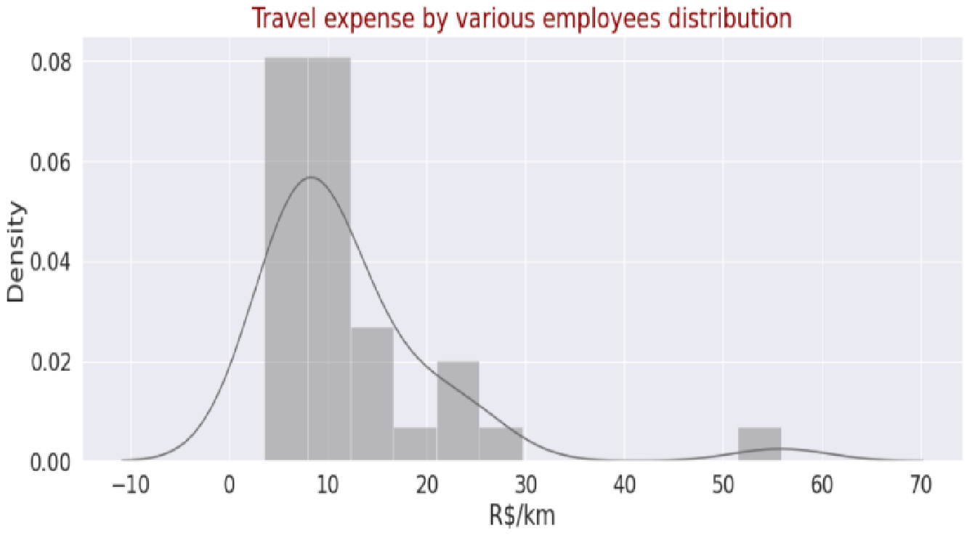
Distribution of Total Expense per km
Insight:
The distribution clearly show that majority of the employees spend approximately less than 10$ per km to travel to the workplace.
But there are also few employees who prefer expensive travel expenses.

Slide 22
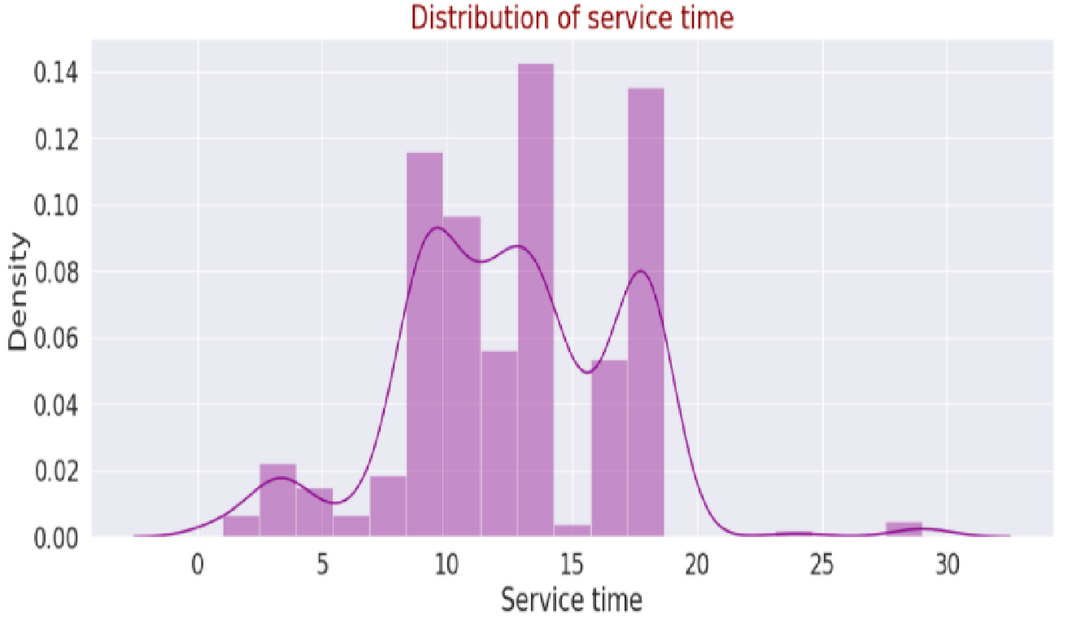
Distribution of Service Time
Insight:
The number of employees having experience less than 10 years is low and the number of employees having experience more than 20 years is negligible.
By observing the probability density curve, it can be seen that majority of the employees are highly experienced as they lie in the period of 10 to 20 years.

Slide 23
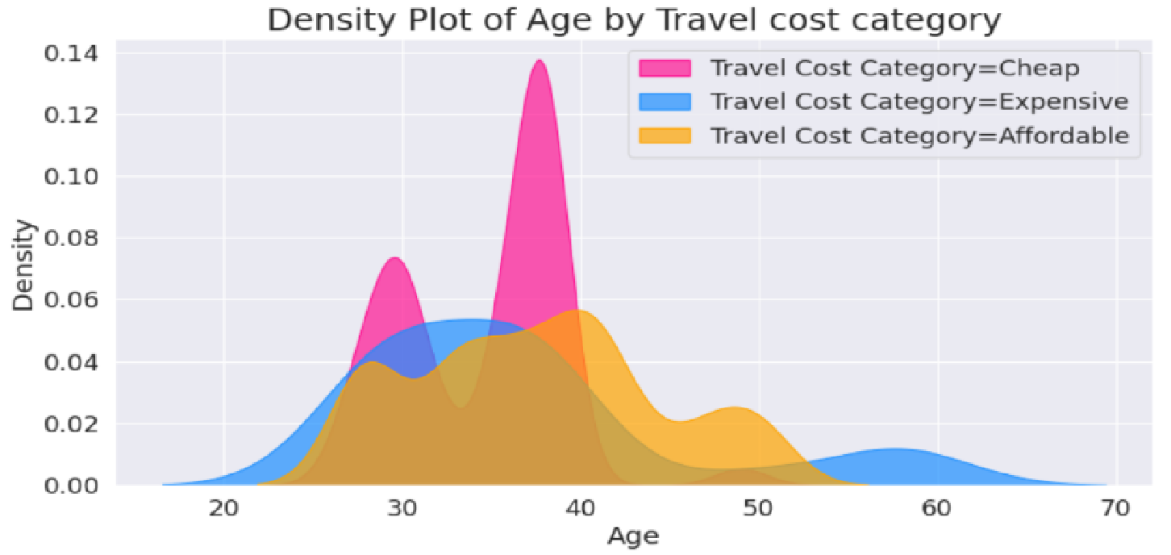
6. Density Plot of Age by Travel Cost Category
Insight:
The graph clearly indicates that majority of the Young and Mid-Age employees belong to Cheap and Affordable Transportation Category and very few prefer Expensive travel.
Old Employees focus on comfort and ease while transportation thus they belong to Affordable or Expensive categories.

Slide 24
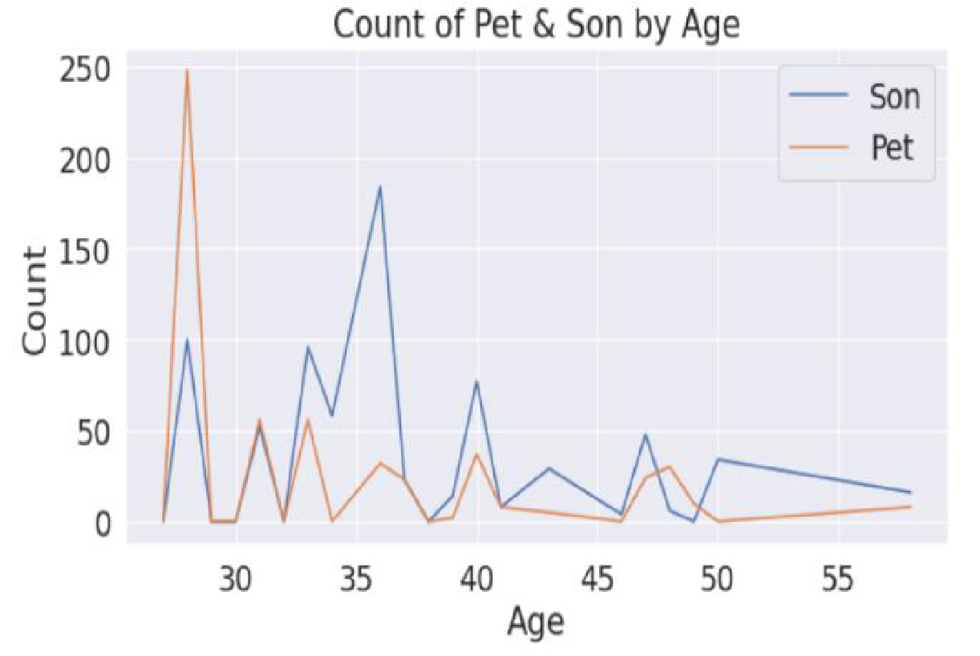
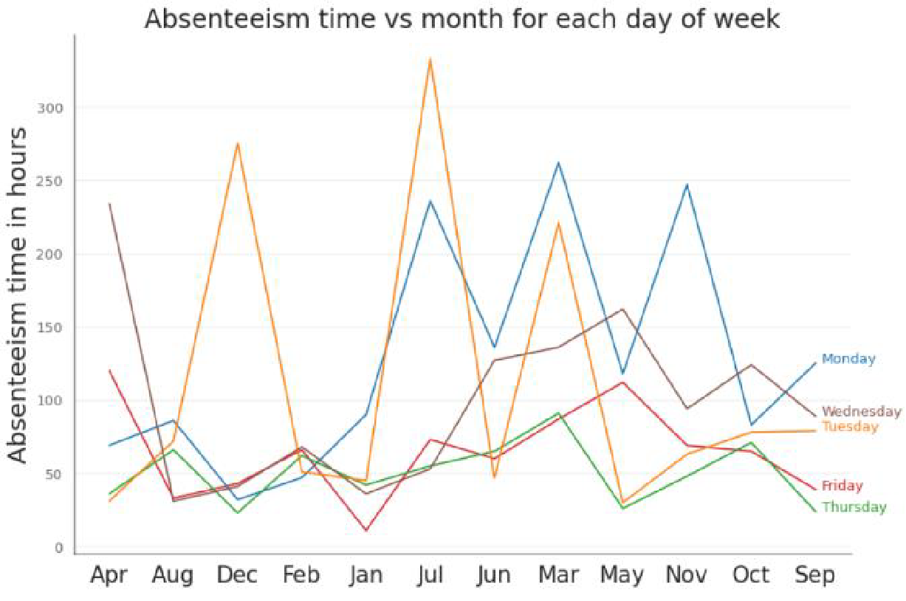
7. Seasonal Plot and Trend Line Chart
Trends between monthly and daily distribution of Absenteeism time in hours and also count of Pet and Son possessed in terms of Age

Slide 25
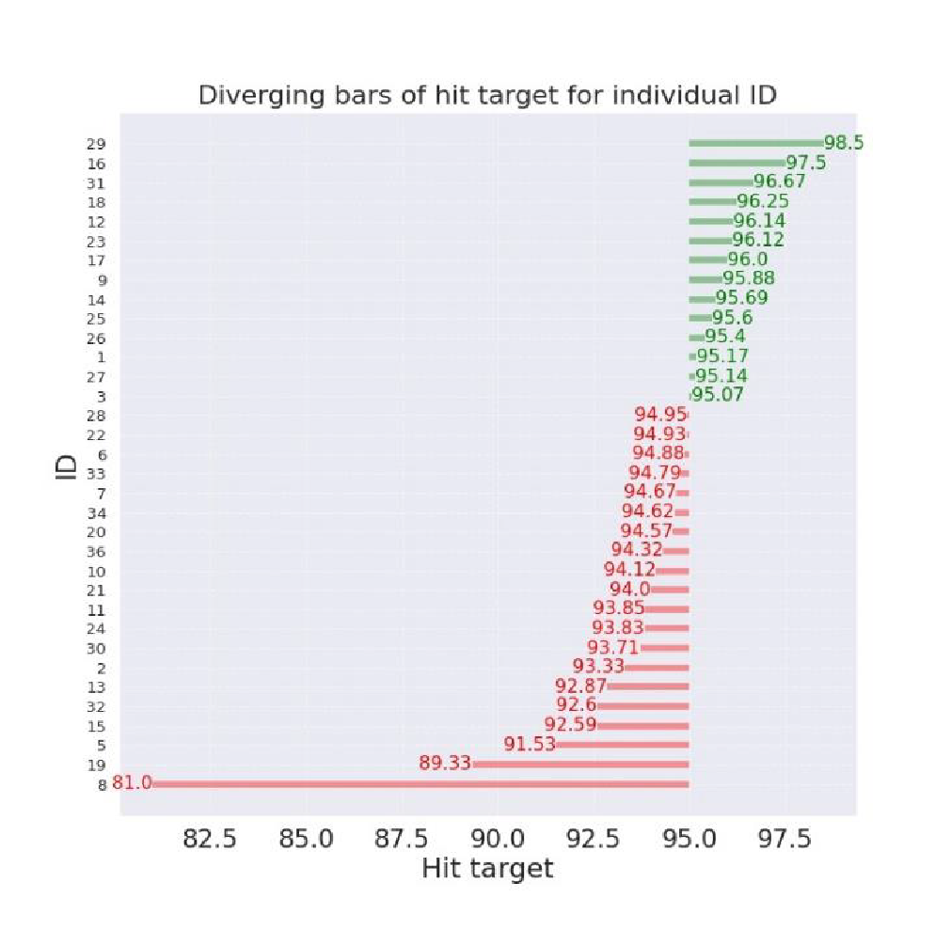
8. Diverging Text Chart
Insight: The graph shows the individuals performing better and worse in terms of completed task. The Green coloured ID’s indicate those individuals that are performing good whereas Red coloured ID’s gives us an idea about the individuals lacking in terms of work assigned to them.
Proposal: Company need to analyse the causes for underperforming individuals. These causes can be lack in skillset, negative corporate culture, or personal issue. Overcoming these causes would definitely help in improvising the growth of the company.

Slide 26
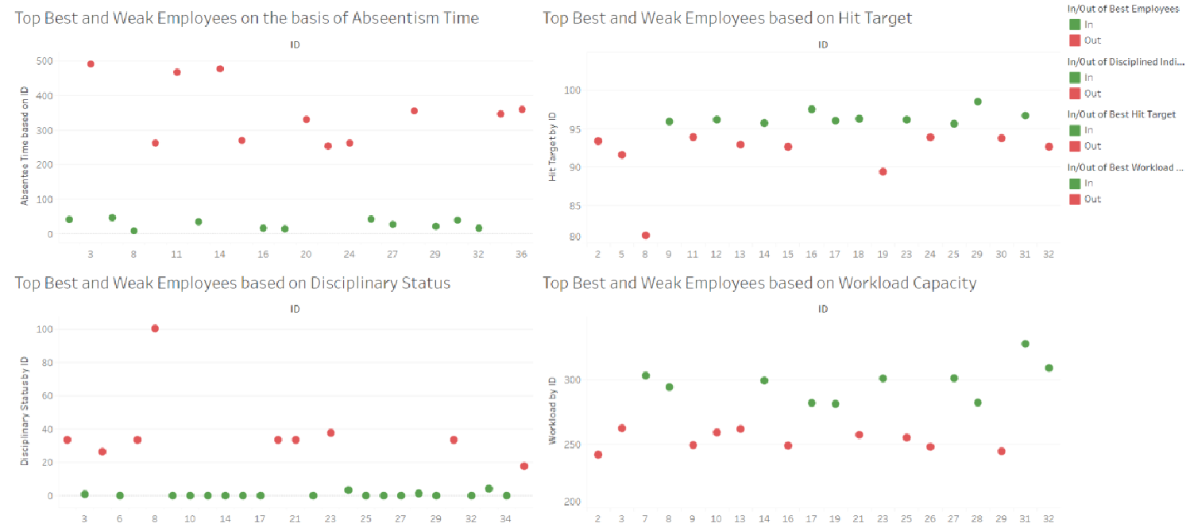
Dot plot for Best and Weak Employees based on major attributes
Using various parameters of interests, employees are classified into Best and Weak categories. The red points in the graph indicate the weak employees, who need further training and improvement, whereas Green points indicate the best employees who can be rewarded to give consistent performance.

Slide 27
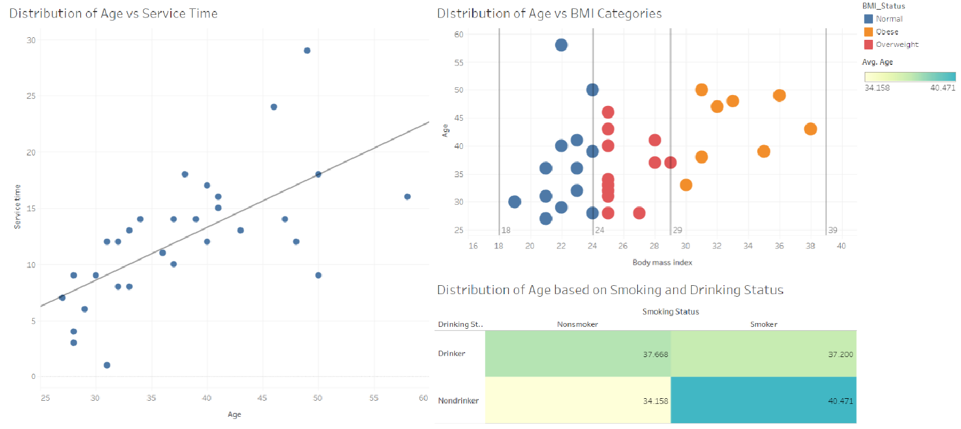
Distribution of Age Parameter with Service Time & BMI Categories of different individuals
Distribution of Age based on Service Time: We can see from the scatter plot indicates that employees tend to stick with the industry for longer duration, indicating that industry is treating their employees in a great manner.
Distribution of Age based on BMI Categories: We see that majority of the Young Age Employees belong to Normal & Overweight Category, but few Mid-Age & Old Employees belong to Obese Category.

Slide 28
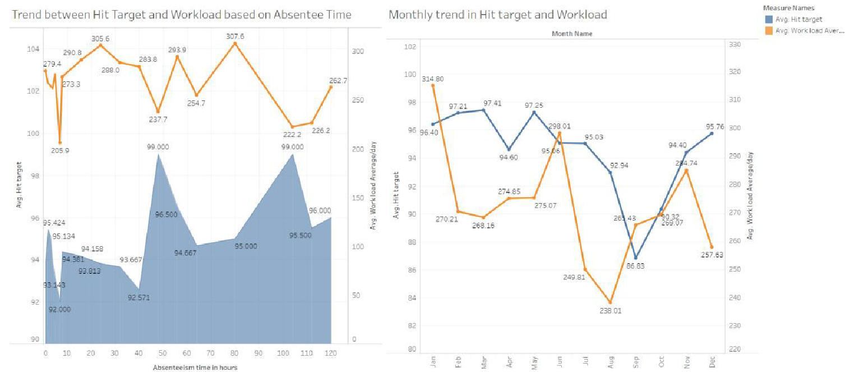
Area Chart and Trend Line Chart between several attributes
Trend between Hit Target, Workload and Absenteeism Time: We can see the trend of Absenteeism Time along with the monthly trends of factors like Hit Target and Workload Capacity.
Monthly Trend in Hit Target and Workload: Here we can see the inverse relationship between the Workload & Target Hit.

